Slide 1

Asia-Pacific Network for Sustainable Forest Management and Rehabilitation
亚太森林恢复与可持续管理组织
The 7ᵗʰ General Assembly for
Asia-Pacific Forestry Education Coordination Mechanism (AP-FECM)

Slide 2

Asia-Pacific Network for Sustainable Forest Management and Rehabilitation
亚太森林恢复与可持续管理组织
Micro-certificate forestry programs to enhance industry-academia collaboration
01
CONTENTS
Technological advancements in forestry sectors and forestry higher education
02
03
Modern forestry education with interdisciplinary curricula

Slide 3
Asia-Pacific Network for Sustainable Forest Management and Rehabilitation
亚太森林恢复与可持续管理组织
Theme One: Micro-certificate forestry programs to enhance industry-academia collaboration

Slide 4
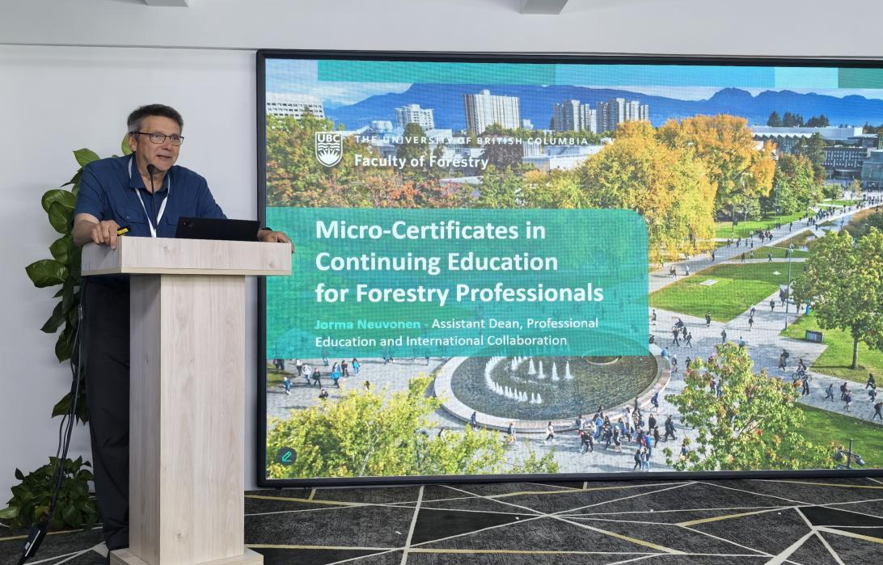
Asia-Pacific Network for Sustainable Forest Management and Rehabilitation
亚太森林恢复与可持续管理组织
Micro-Certificates in Continuing Education for Forestry Professionals
Jorma Neuvonen
Assistant Dean,Professional Education and International Collaboration,Faculty of Forestry,
University of British Columbia(UBC)
01

Slide 5
Asia-Pacific Network for Sustainable Forest Management and Rehabilitation
亚太森林恢复与可持续管理组织
Prof. Jorma Neuvonen stated that the UBC Faculty of Forestry has developed industry-aligned micro-certificates to address the critical need for flexible, practical, and accredited continuing education for working forestry professionals. These industry-recognized programs, developed with employers and aligned with BC's framework and regulatory requirements, focus on in-demand areas such as climate adaptation, wildfire management, and forest carbon management. The modular online programs culminate in shareable digital certificates and are designed for accessibility, featuring flexible scheduling, applied learning from expert instructors (both academic and industry), and are marketed directly to professionals and organizations to fill critical skills gaps in the evolving forestry sector.

Slide 6
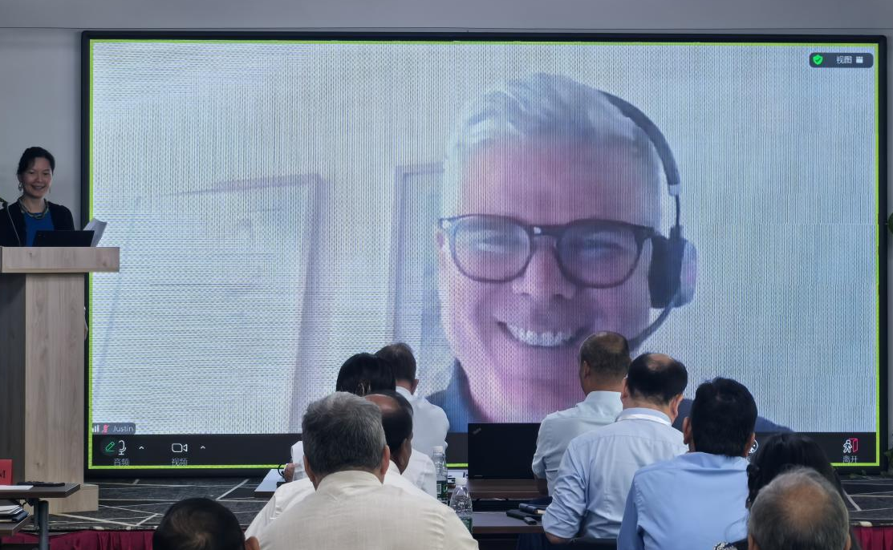
Asia-Pacific Network for Sustainable Forest Management and Rehabilitation
亚太森林恢复与可持续管理组织
02
New Zealand Professional Development Workshops-Learning Together with our Forest Industry
Justin Morgenroth(online)
Deputy Head of Forestry School, University of Canterbury (UC)

Slide 7
Asia-Pacific Network for Sustainable Forest Management and Rehabilitation
亚太森林恢复与可持续管理组织
Prof. Justin Morgenroth shared that the Canterbury University School of Forestry offered practical, industry-driven Professional Development Workshops in a variety of areas including winch-assist logging, forest road construction, lidar analysis, and use of AI in forestry. These workshops combine lectures and practical exercises, facilitating discussion and knowledge exchange, directly responding to industry needs and sector development. While exploring future steps like online delivery and formal micro-certificates, the school recognizes the challenge of balancing broader accessibility with preserving the unique benefits of "in-classroom" experience.

Slide 8
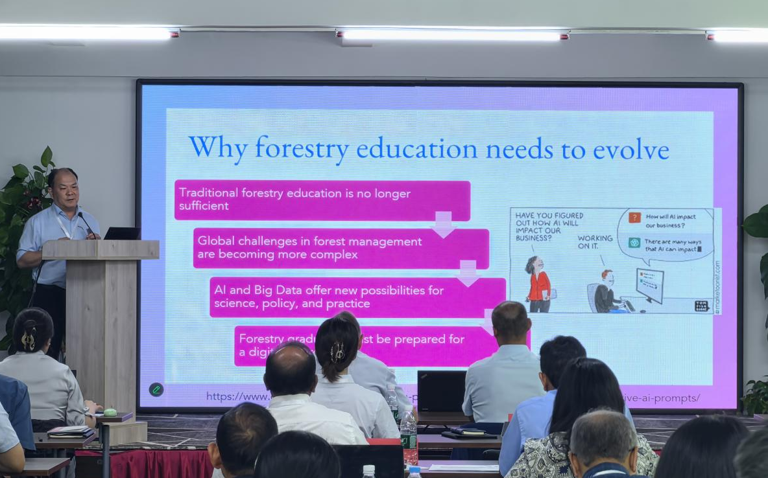
Asia-Pacific Network for Sustainable Forest Management and Rehabilitation
亚太森林恢复与可持续管理组织
Transforming Forestry Higher Education: Integration of AI and Big Data
Wang Guangyu
Associate Dean, Asian Strategies,Faculty of Forestry,UBC
03

Slide 9
Asia-Pacific Network for Sustainable Forest Management and Rehabilitation
亚太森林恢复与可持续管理组织
Dr. Wang Guangyu argued that forestry education must urgently integrate AI and big data to address complex global challenges, bridge the digital skills gap, and prepare graduates for tech-driven careers in areas like automated forest inventory, disease prediction, and carbon estimation. The key applications for AI and big data include the use of Large Language Models (LLM) for education, research and decision support, and computer vision for critical tasks (e.g., tree detection, health monitoring, deforestation prevention, wildfire management). These applications offer advantages in terms of scalability, speed, accuracy, and data-driven insights. Despite challenges such as limited faculty capacity, inadequate infrastructure, and ethical concerns, forestry education must innovate, integrating digital technologies, ecological expertise, and cross-border collaboration to cultivate future forestry professionals as "ecologists + data scientists + communicators" for a sustainable forest future.

Slide 10
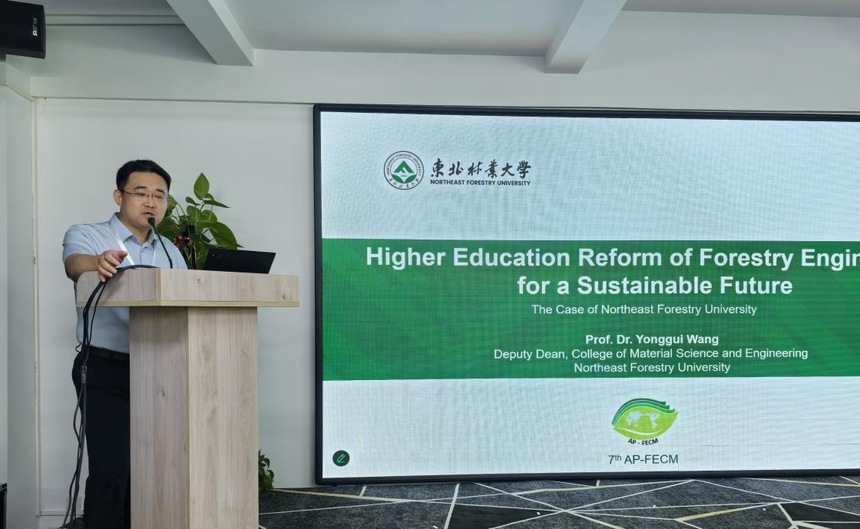
Asia-Pacific Network for Sustainable Forest Management and Rehabilitation
亚太森林恢复与可持续管理组织
Higher Education Reform of Forestry Engineering for a Sustainable Future:The Case of Northeast Forestry University
Wang Yonggui
Deputy Dean,College of Material Science and Engineering, Northeast Forestry University (NEFU)
03

Slide 11
Asia-Pacific Network for Sustainable Forest Management and Rehabilitation
亚太森林恢复与可持续管理组织
Dr. Wang Yonggui stated that NEFU was driving education reform in Forestry Engineering through AI integration (e.g., knowledge mapping, customized learning); innovation and entrepreneurship programs (e.g., Biomass-X Lab); and curriculum alignment with dual-carbon goals—focusing on biomass and renewable energy. The university fosters international collaboration via 48 international partnerships, a joint PhD program, virtual summer camps, and academic conferences. These initiatives collectively aim to cultivate sustainability-oriented professionals through interdisciplinary, global, and practice-based education, thereby promoting green innovation in forestry engineering and supporting global sustainability goals.

Slide 12
Asia-Pacific Network for Sustainable Forest Management and Rehabilitation
亚太森林恢复与可持续管理组织
Theme Two: Technological advancements in forestry sectors and forestry higher education

Slide 13
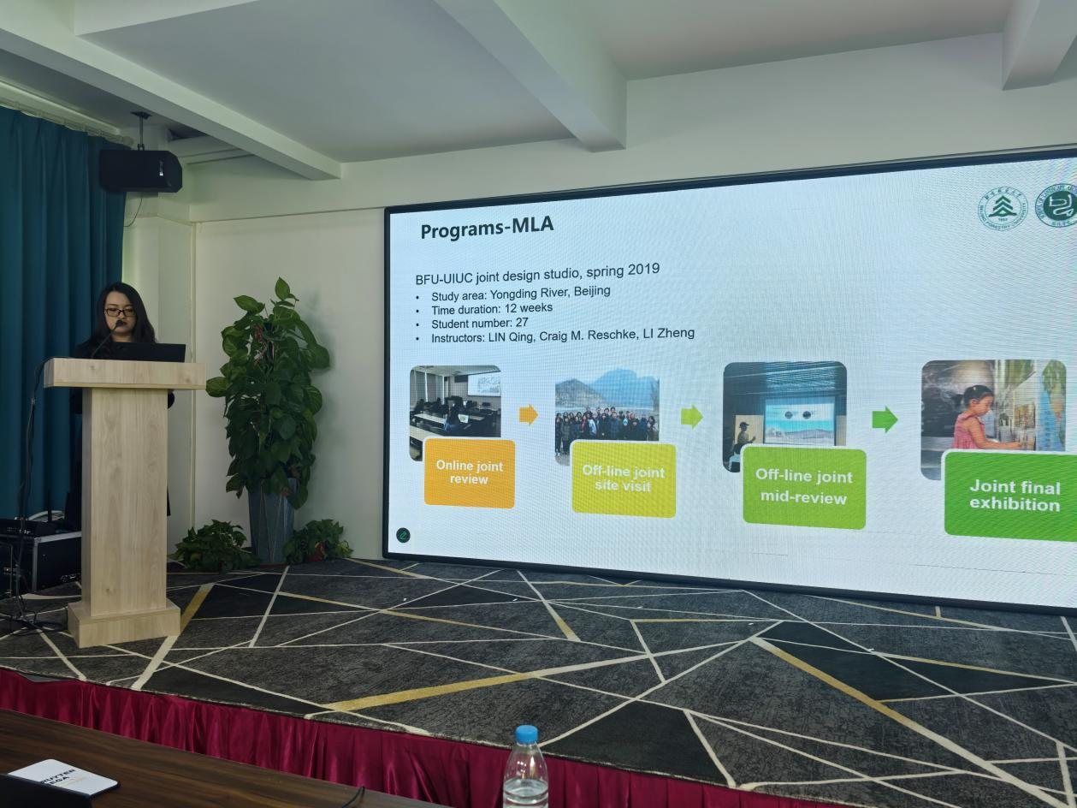
Asia-Pacific Network for Sustainable Forest Management and Rehabilitation
亚太森林恢复与可持续管理组织
AI Workflow in Landscape Architecture Education: Evidence from the College of Landscape Architecture in Beijing Forestry University
Zhao Jing
Deputy Dean of the College of Landscape Architecture, Beijing Forestry University
03

Slide 14
Asia-Pacific Network for Sustainable Forest Management and Rehabilitation
亚太森林恢复与可持续管理组织
Dr. Zhao Jing stated that landscape architecture education and practice were undergoing a profound digital transformation. She introduced the development of a comprehensive digital and intelligent workflow, and the creation of specialized AI tools like knowledge graphs, language models, and automated systems for site analysis, planning, 3D modeling, and cost evaluation. The initiative culminates in the "LANDSCAPE Agent" concept, demonstrating an AI-powered workflow from concept to detailed design and assessment.

Slide 15
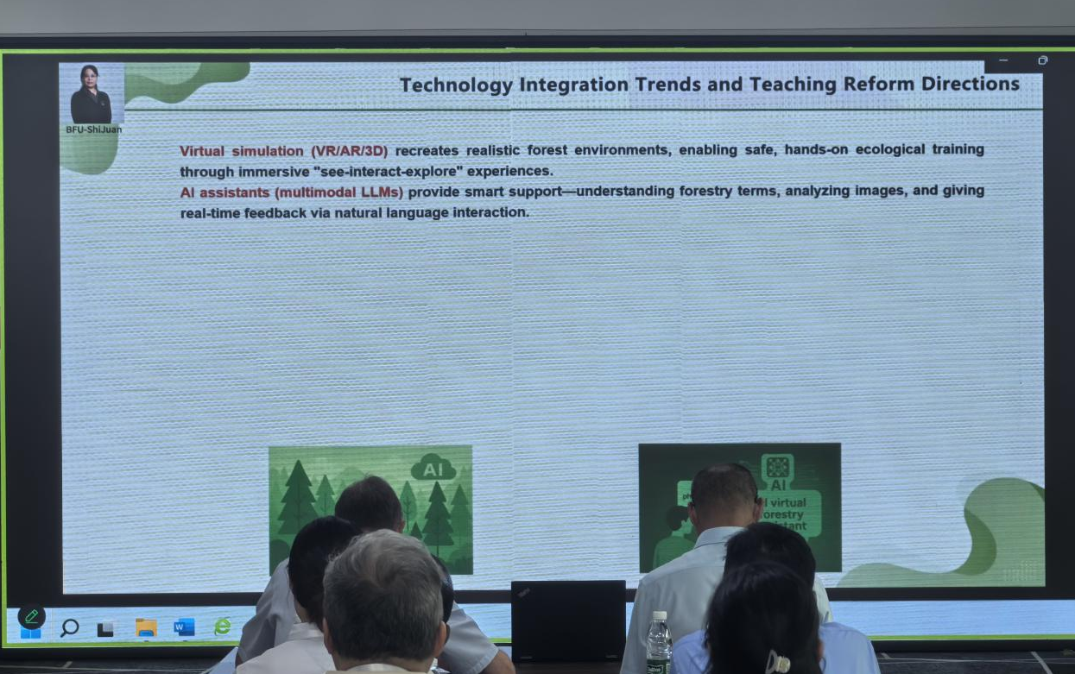
Asia-Pacific Network for Sustainable Forest Management and Rehabilitation
亚太森林恢复与可持续管理组织
03
AI Empowers Forestry Teaching Practices and Reshapes Forestry Education
Shi Juan (online)
Deputy Dean, School of Forestry, Beijing Forestry University

Slide 16
Asia-Pacific Network for Sustainable Forest Management and Rehabilitation
亚太森林恢复与可持续管理组织
Dr. Shi Juan stated that AI and virtual simulation technologies were revolutionizing forestry education by creating immersive, intelligent learning systems. They overcome traditional limitations such as safety risks, field inaccessibility, and irreversible procedures through virtual training, smart teaching and assessment systems, and AI-powered teaching assistants. These new teaching methods foster deeper understanding, personalized learning, and practical skills development while reshaping pedagogy towards teacher-led, AI-supported collaboration.

Slide 17
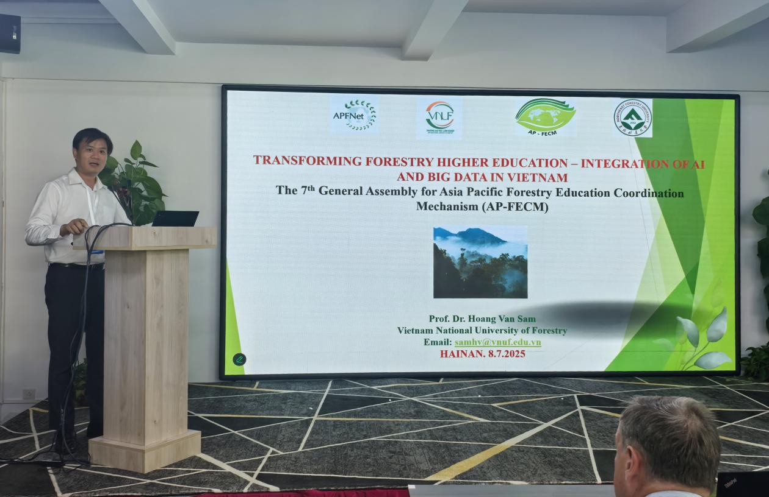
Asia-Pacific Network for Sustainable Forest Management and Rehabilitation
亚太森林恢复与可持续管理组织
03
Transforming Forestry Higher Education: Integration of AI and Big Data in Vietnam
Hoàng Văn Sâm
Director, International Cooperation Division, Vietnam National University of Forestry

Slide 18
Asia-Pacific Network for Sustainable Forest Management and Rehabilitation
亚太森林恢复与可持续管理组织
Dr. Hoàng Văn Sâm outlined Vietnam's significant forest biodiversity, noting its high proportion of endemic species. He highlighted Vietnam National University of Forestry (VNUF) as the core institution training over 70,000 graduates, including international students, across diverse forestry programs. He emphasized practical achievements of AI technology in forest resource management, biodiversity conservation, fire warning systems, and forest educational research.

Slide 19
Asia-Pacific Network for Sustainable Forest Management and Rehabilitation
亚太森林恢复与可持续管理组织
Theme Three: Modern forestry education with interdisciplinary curricula

Slide 20
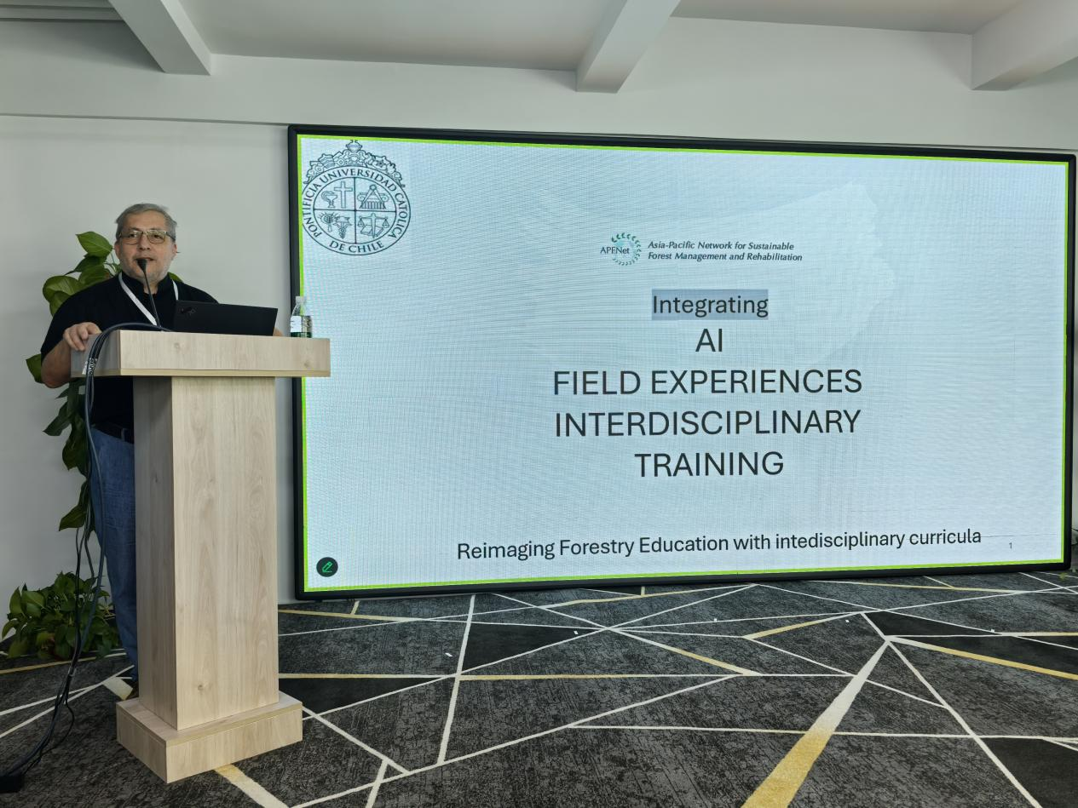
Asia-Pacific Network for Sustainable Forest Management and Rehabilitation
亚太森林恢复与可持续管理组织
Reimagining Forestry Education for the 21st Century: Integrating AI, Field Experiences, and Interdisciplinary Training
Cristián Bonacić
School of Agriculture and Forestry, Pontificia Universidad Católica de Chile
01

Slide 21
Asia-Pacific Network for Sustainable Forest Management and Rehabilitation
亚太森林恢复与可持续管理组织
Dr. Cristián Bonacić argued that modern forestry education must be transformed to address the challenges of disconnected, digitally-native urban students and the risks of uncritical AI reliance, while meeting industry needs for adaptable professionals. The core solution is integrating rigorous field experiences (‘learning by doing’) to build resilience, practical skills, and critical thinking, combined with cautious AI training, fostering a new generation of foresters equipped for hybrid tech-field environments. He concluded by inviting Asia-Pacific universities to a 10-day Chilean field course showcasing diverse ecosystems and management challenges.

Slide 22
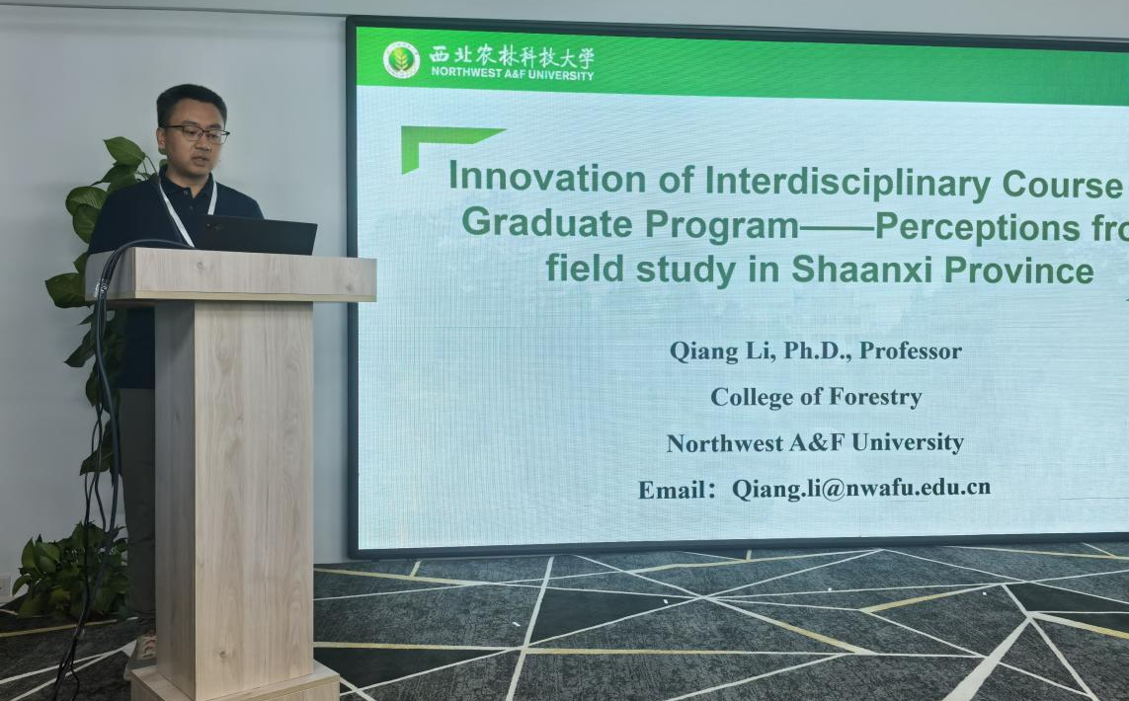
Asia-Pacific Network for Sustainable Forest Management and Rehabilitation
亚太森林恢复与可持续管理组织
Innovation of Interdisciplinary Course for Graduate Program-Perceptions from the Field Study in Shaanxi
Li Qiang
College of Forestry, Northwest Agriculture and Forestry University
01

Slide 23
Asia-Pacific Network for Sustainable Forest Management and Rehabilitation
亚太森林恢复与可持续管理组织
Dr.Li Qiang indicated that the Northwest A&F University , a leading Chinese institution in agriculture and forestry, hosted the APFNet Master's Program training international forestry professionals. This two-year, English-taught program combines strong tanagement and ecology with extensive practical field studieheoretical coursework in areas like sustainable forest ms across diverse ecosystems in Shaanxi. Through this integrated approach, students have understood global forestry trends and ecological solutions, preparing them for careers as experts in regional forest management, ecological restoration, and global sustainable resource management.

Slide 24
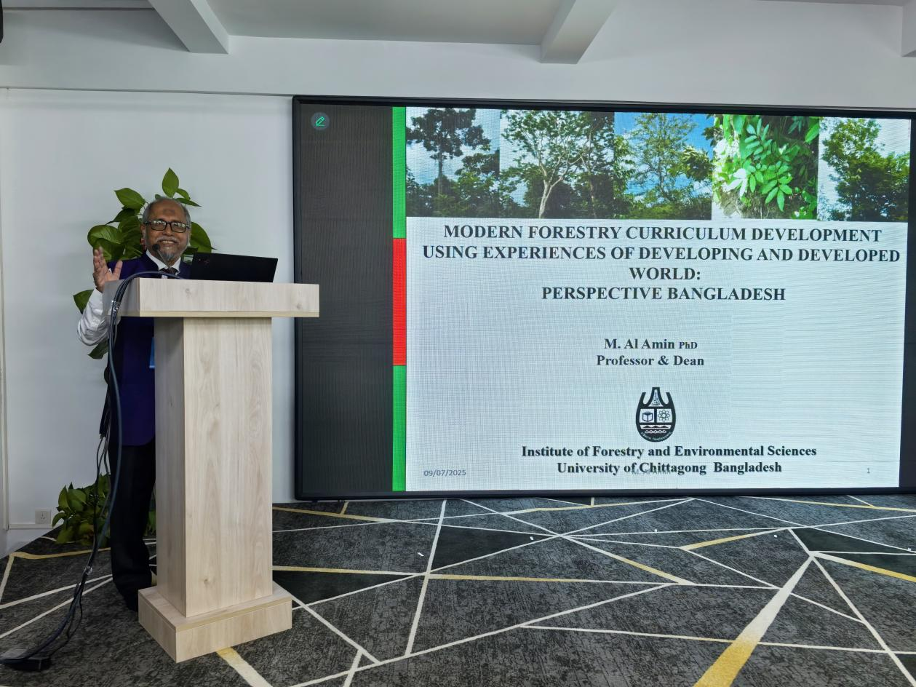
Asia-Pacific Network for Sustainable Forest Management and Rehabilitation
亚太森林恢复与可持续管理组织
Modern Forestry Curriculum Development Using Developing and Developed World Experiences:
Perspective Bangladesh
Mohammed Al-Amin
Institute of Forestry and Environmental Sciences, University of Chittagong
01

Slide 25
Asia-Pacific Network for Sustainable Forest Management and Rehabilitation
亚太森林恢复与可持续管理组织
Prof. Mohammed Al-Amin shared that the Institute of Forestry and Environmental Sciences, University of Chittagong (IFESCU) is modernizing its forestry curriculum through a structured quality assurance process incorporating stakeholder input on emerging topics such as climate change adaptation, REDD+, and digital tools. This reform leverages online learning methods and international collaborations for capacity building, but still faces challenges like equitable access to resources and rising academic misconduct. The initiative represents a paradigm shift in Bangladeshi forestry education, aiming to align with global standards and address contemporary socio-ecological challenges.

Slide 26
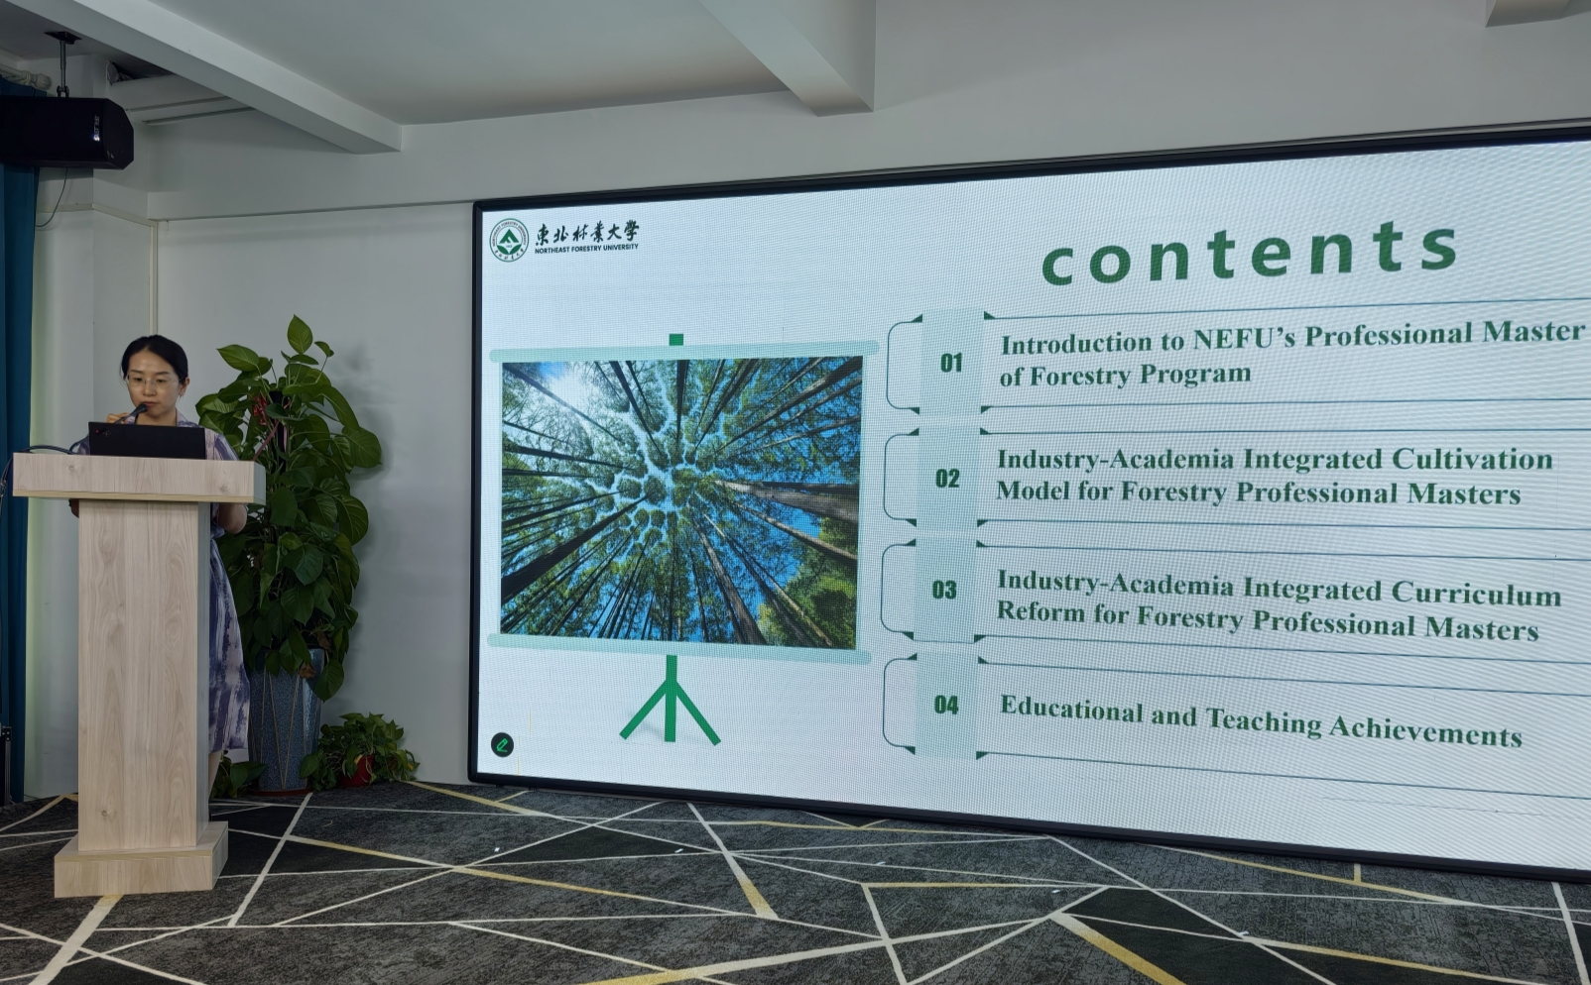
Asia-Pacific Network for Sustainable Forest Management and Rehabilitation
亚太森林恢复与可持续管理组织
Industry-Academia Integration in Master of Forestry (MF) Program: Cultivation Model and Curriculum Reform at Northeast Forestry University
Han Donghui
Faculty of Forestry, Northeast Forestry University (NEFU)
01

Slide 27
Asia-Pacific Network for Sustainable Forest Management and Rehabilitation
亚太森林恢复与可持续管理组织
Prof. Han Donghui stated that Northeast Forestry University (NEFU) pioneered an industry-academia integrated cultivation model for its Forestry Professional Master’s program, featuring a rigorous admissions process, dual academic-industry mentorship, and diverse educational bases. Curriculum reforms emphasize real-world problem solving through VR/AI simulations (e.g. forest fire prevention simulations), competency-based assessments, and technology-enhanced learning platforms. This approach has yielded significant educational achievements, including national teaching awards and extensive adoption of NEFU-published textbooks across China.

Slide 28
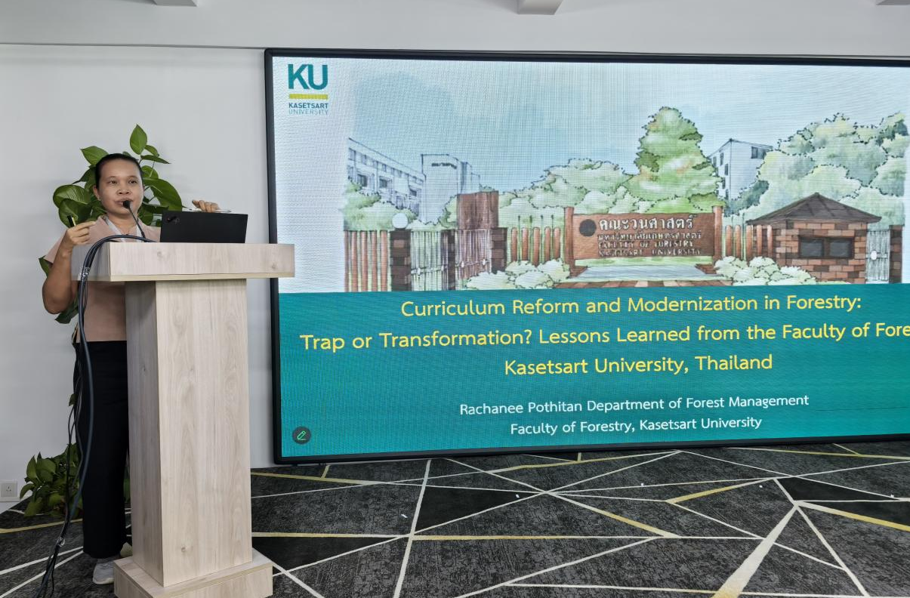
Asia-Pacific Network for Sustainable Forest Management and Rehabilitation
亚太森林恢复与可持续管理组织
Curriculum Reform and Modernization in Forestry:Trap or Transformation? Lessons Learned from the Faculty of Forestry, Kasetsart University, Thailand
Rachanee Pothitan
Faculty of Forestry, Kasetsart University
01

Slide 29
Asia-Pacific Network for Sustainable Forest Management and Rehabilitation
亚太森林恢复与可持续管理组织
Prof. Rachanee Pothitan stated that the Forestry Faculty of Kasetsart University undertook a comprehensive curriculum reform to transition from traditional content-heavy teaching to an outcome-oriented, competency-focused model aligned with Thailand's national standards and stakeholder needs. While the reform successfully integrated modern themes (e.g., climate change, GIS) and new teaching methods, it faced challenges including faculty resistance, resource constraints, and risks of superficial implementation. The shift marked a genuine transformation but requires sustained institutional commitment, resource investment, and stakeholder engagement to ensure long-term relevance in addressing evolving forestry challenges.

Slide 30
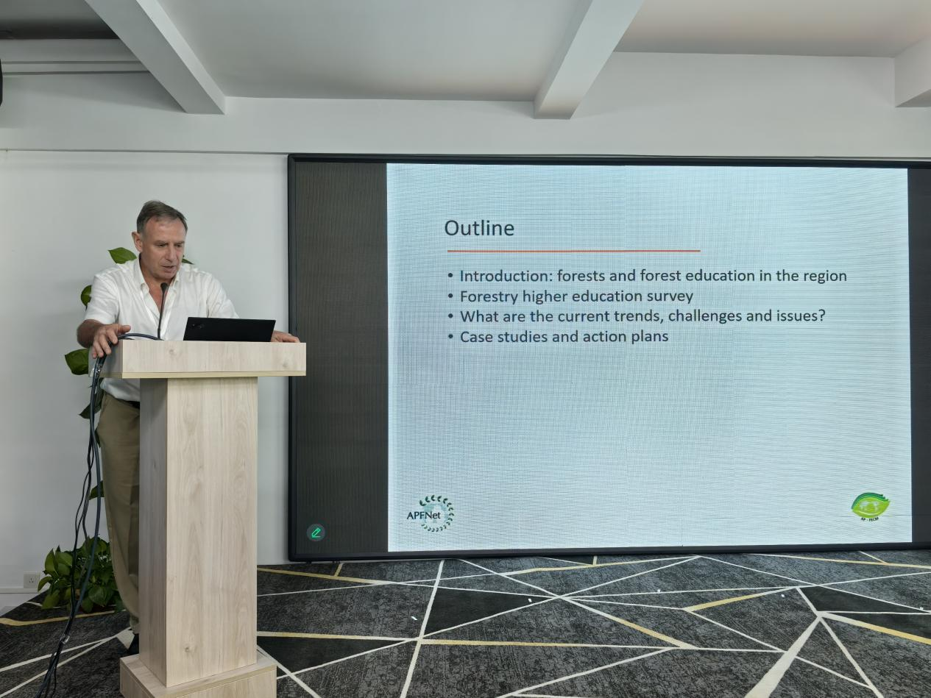
Asia-Pacific Network for Sustainable Forest Management and Rehabilitation
亚太森林恢复与可持续管理组织
01
AP-FECM Higher Forestry Education (2016-2025) Survey Report
John Innes
Chair of AP-FECM,University of British Columbia (UBC)

Slide 31
Asia-Pacific Network for Sustainable Forest Management and Rehabilitation
亚太森林恢复与可持续管理组织
Dr. John Innes presented the survey report on higher forestry education (2016-2025) in the Asia Pacific Region, which reveals a significant transformation towards specialized, digitally-integrated programs focused on climate action, ecosystem governance, and community co-management. This evolution is marked by new specialized degree programs, the rise of micro-certification, increased technology use in teaching, and growing graduate employment in this field. However, challenges persist，including uneven regional access, digital divides, and academic integrity concerns. The survey demonstrates promising initiatives in curriculum reform, cross-border mobility, and community partnerships, while its recommendations emphasize expanding survey participation, leveraging online investments, and sustaining collaboration to strengthen forestry education for sustainable forest management.

